Slide 1







Part of Franchise Mannual
Franchise Onboarding
Manual
(In Summary)
Find Us On Web - Business Insights

Slide 2
Part of Franchise Mannual
WHO ARE WE?
We are Business Connectors
THE GLOBAL BUSINESS CONNECTORS

Slide 3



WHO ARE WE
WE ARE ENABLER OF TURNING YOUR IDEAS INTO POWERFUL MONEY MACHINES
WE ARE
BUSINESS CONNECTORS
WE ARE FIND US ON WEB.
We help you Connect , Network and Get Found in the online and offline world. We help you grow your business as per your needs.
THE GLOBAL BUSINESS CONNECTORS

Slide 4
Part of Franchise Mannual
What We Do
We help businesses step up through organic growth
We help businesses to turn their ideas or ventures into a powerful money machines in 3-5 years by reaching from £0 to £1million revenue guaranteed for each idea or the assignment with our proven strategic and tactical tools

Slide 5

Part of Franchise Manual
We are working with aspiring businesses to build a global business growth community and to help them connect and network with each other locally, nationally and globally.
WE HELP BUSINESSES TO TURN THEIR IDEAS INTO A POWERFUL MONEY MACHINES IN
3 TO 5 YEARS BY REACHING FROM 0 TO 1MILLION POUND REVENUE
We are enabling businesses to help them achieve their strategical business goals and objectives with our “Business Growth Accelerator” programme. In addition, we are helping businesses to step up through organic growth as per their goals and aspiration with our range of tactical business tools in line with their day to day business needs.
We work with business stakeholders to understand their inspirational growth plan and enable them to achieve their objectives targeted for next 1-3 years.
We work very closely with our community members and bring guaranteed more savings, guaranteed more customers and guaranteed more sales for them.

Slide 6



Part of Franchise Mannual
Values We Create
Guaranteed More
Guaranteed More
Guaranteed More
CONNECTIONS
SAVINGS
LEADS
Guaranteed More Growth
Guaranteed More
Guaranteed More
Guaranteed More
TRANSACTIONS
SALES
PROFITS

Slide 7
Part of Franchise Mannual
Services We Offer
Advertising
Sales Promotions
Selling (Products and Services)
Direct Marketing
Profitability Enhancement
Capital and Finance Planning
Business Coaching and mentoring
Business Growth Acceleration
Target Marketing
PR and Loyalty Building
Cash Flow Improvement
Business Planning and Masterclasses

Slide 8
Part of Franchise Mannual
Tactical Tools We use
Speed Networking
Vouchers & Local Deals
Ratings & Reviews
Magazine Publication
Speaking Engagement
Display Banner Stands
Sponsorships
Trade Shows
The Business Show & Exhibition
Annual Conference
Awards and Achievement Nights
Media Promotions, PR & Loyalty Program

Slide 9
Part of Franchise Mannual
THE BUSINESS PUZZLE
Find a way out of everyday business challenges and get over the day to day business hurdles

Slide 10
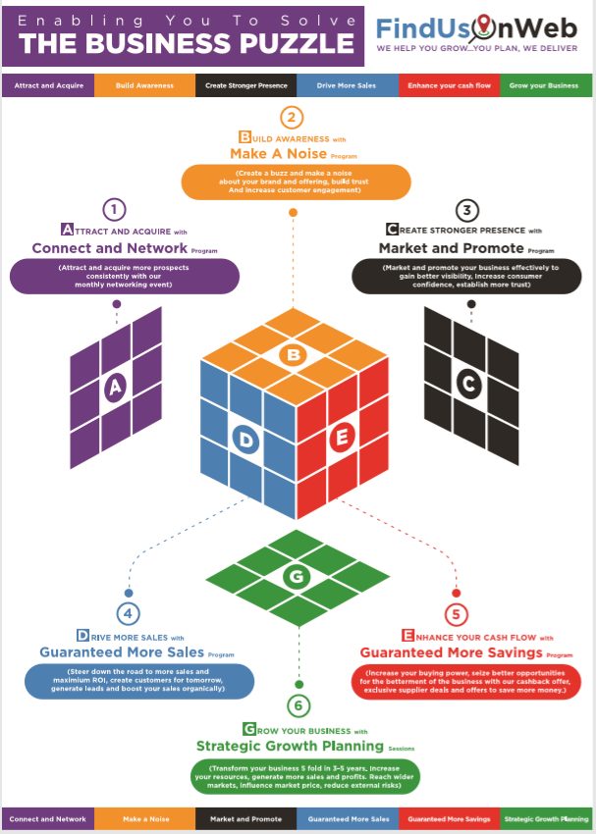
We Act As A Catalyst To Help Our Community Members Solve Their Business Puzzle And Help Them Build A Million Pound Revenue Model In 3 To 5 Years
Part of Franchise Mannual

Slide 11
Part of Franchise Mannual
Team Introduction

Slide 12
Part of Franchise Mannual
Franchise Location Support Roles and Responsibilities

Slide 13
Part of Franchise Mannual
What do you need
to do for
this success journey
From day one of your franchise

Slide 14

Part of Franchise Mannual
7 STEP FORMULA FOR SUCCESS
1. Plan your goals and success strategy
2. Learn our proven tools and techniques
3. Engage with local businesses
4. Build rapport with local businesspeople
5. Follow the 12 steps of the success path
7. Achieve your goals and objectives
6. Guide, help and support your own local business community

Slide 15
Part of Franchise Mannual
FRANCHISE SUCCESS STRATEGY
Formula for Success (Minimum Commitment)
Task
Quarter 1
Quarter 2
Quarter 3
Quarter 4
Minimum Engagement Target
50
250
1250
1000PC
Ideal Engagement Target
150
600
1800
10000PC
Plan your goals | Learn and follow the processes
Manage Networking Events & Trade shows
Manage the Print promotional materials
Manage Profile Reviews and Recommendations
Participate in Award Nights and Achieve Results

Slide 16
Part of Franchise Mannual
The Role of a Franchise
Find Us On Web - Business Insights

Slide 17
Part of Franchise Mannual
What to expect from this partnership
From day one of your franchise

Slide 18
Part of Franchise Mannual
WHAT TO EXPECT IN WEEK ONE
Introduction to the team
Discuss the support roles and responsibilities
Allocate a relationship manager to help
Set your Projected Income goals
Set your “Connect and Network” Goals
Set your projected business value goals
Set up social media profile pages for the location
Plan, agree and schedule the daily support meetings
Plan and agree the event dates for next 12 months
Agree the meeting date for week two

Slide 19
Part of Franchise Mannual
Set your Projected Income Goals

Slide 20



Franchise Onboarding – Set your Financial Goals and Objectives
Part of Franchise Mannual
Set Your Financial Income Goals
Typical projected income goals for POC year is 30K
YEARLY PROJECTED FINANCIAL INCOME GOALS FOR EACH FRANCHISE LOCATION IN AN OPERATIONAL YEAR AFTER POC (TESTING THE WATER)
OP YEAR
OP YEAR
OP YEAR
1
2
3
30-40K
50-70K
100-120K

Slide 21
Part of Franchise Mannual
Set your projected business value goals
£1,250,000
1250
Worth Business Value Generated Per Year Per Location
New Customers Severed Per Year Per Location
What each customer engagement takes
2-4
1-2
0-1
1-2
Email Response Per Month
Phone Call Response Per Month
Meetings Per Month
Phone Call Response Per Month

Slide 22
Part of Franchise Mannual
Set your daily Connect and Network Goals
50-100
50-60
30-50
LinkedIn Messages
Emails
LinkedIn Connections
5-8
4-5
20-30
Face to Face meeting (20-30 Min each)
New Enrolments
Phone Calls
Make sure you have identified atleast one hook up point in every discussion
Also, you have got atleast one action point from each interaction for next meeting
and agreed a slot in diary to meet up again in next 1-2 weeks

Slide 23
Part of Franchise Mannual
Set Up Social Media Pages for the Location

Slide 24
Part of Franchise Mannual
Plan, agree and schedule
the daily
support meetings

Slide 25
Part of Franchise Mannual
Plan and agree
the event dates
for next 12 months

Slide 26
Part of Franchise Mannual
Agree
the meeting dates
for next two weeks

Slide 27
Part of Franchise Mannual
WHAT TO EXPECT IN MONTH ONE
1. Learn our proven tools and techniques
2. Ways to set yourself to become a brand which inspires people
3. Understand The Business Values Behind Our Proven Tools
4. Set your Social Profile/Email/Mobile and other contact details
5. Plan your Goals and Objectives
6. Engage with Local Businesses
7. Learn “connect and network” strategy using LinkedIn
8. Plan your region & organise additional data
9. Agree the meeting date for first Quarterly Review meeting
Find Us On Web - Franchise Business Insights

Slide 28
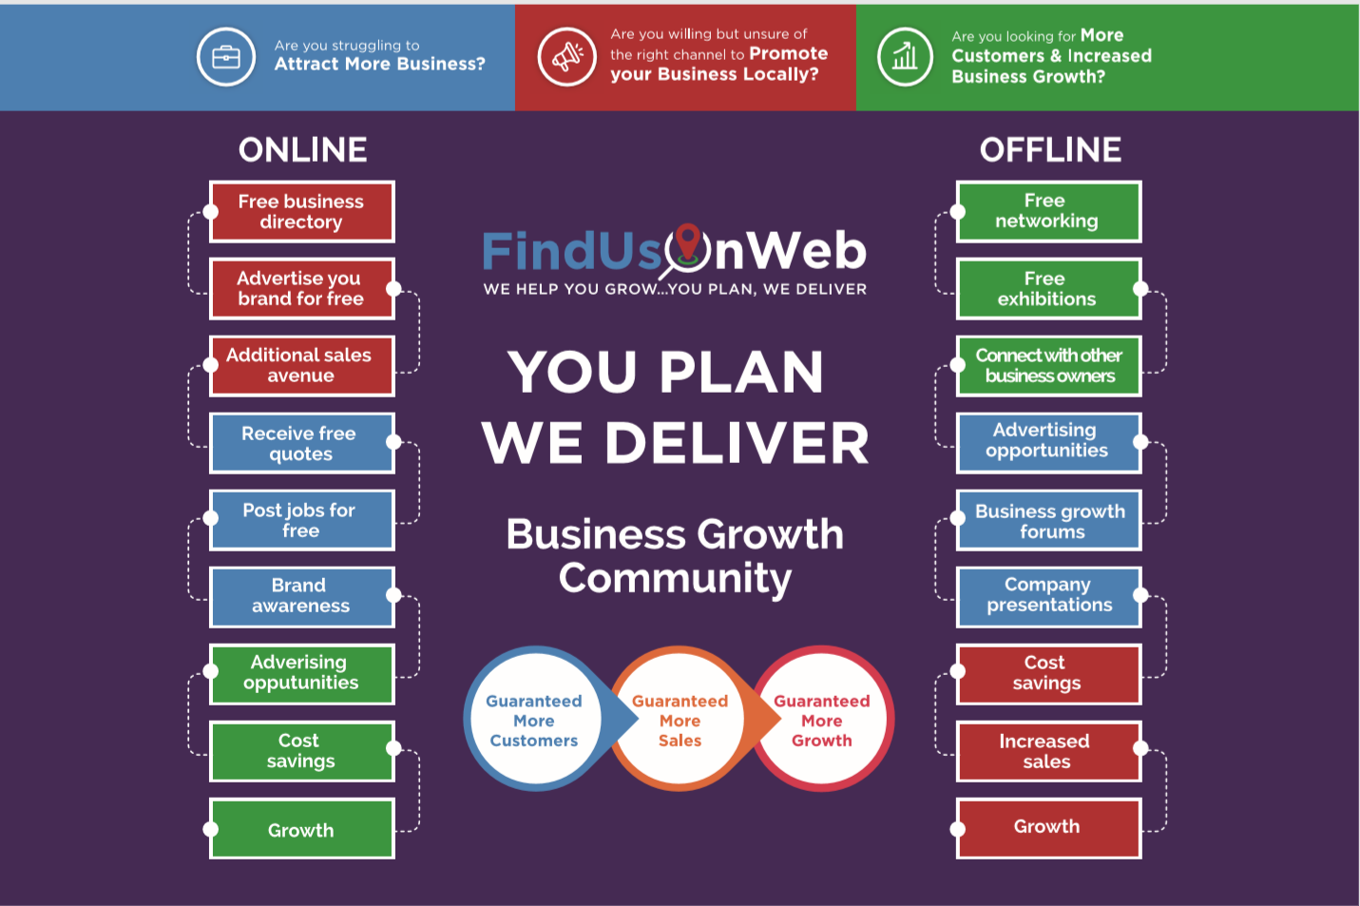

Part of Franchise Mannual
LEARN OUR PROVEN TOOLS AND TECHNIQUES
Find Us On Web - Franchise Business Insights

Slide 29
Part of Franchise Mannual
Ways to set yourself to become a brand which inspires people
Set Your Offline And Online Identity
Choose and Set Your
Dress Code
Stay Prepared For Meetings
Know Your Tools
Plan For Success
Know Your Customers

Slide 30
Part of Franchise Mannual
Understand The Business Values Behind Our Proven Tools And Techniques
£0.01
£0.25
£6.40
is the projected ROI of each email send
is the projected ROI of each phone call dialed
is the projected ROI of each meeting scheduled
£0.11
£0.66
£8.00
Is the projected ROI of each email response Received
is the projected ROI of each phone call responded
is the projected ROI of each meeting occurred

Slide 31
Part of Franchise Mannual
Set your Social Profile/ Email/Mobile and Other contact details

Slide 32

Part of Franchise Mannual
Engage With
Local Businesses
Establish and maintain a long lasting business relationship within your local business community
Find Us On Web - Franchise Business Insights

Slide 33
Part of Franchise Mannual
Science Says 92 Percent of People Don't Achieve Their Goals.

Slide 34


Part of Franchise Mannual
PLAN YOUR GOALS AND OBJECTIVES
People don't plan to fail, they fail to plan.
92% People
8% People
Fail to plan their goals and objectives and face high risk and problems
Plan for their success and achieve their results

Slide 35

Part of Franchise Mannual
Learn “connect and network” strategy using LinkedIn
Find Us On Web - Franchise Business Insights
Notes:
Did you know that a staggering 92 percent of people that set New Year's goals never actually achieve them? That's according to research by the University of Scranton.
I've done it many times, and if you're like me -- a driven, type-A entrepreneur -- failing to meet goals can set you back and leave you discouraged and frustrated. (I even felt it as I typed that sentence.)
Here's the thing: If you want to break the cycle, do what the other 8 percent of goal-setters -- the successful ones -- do consistently and exceptionally well.
Set goals that are SMART, specific and challenging (but not too hard).
Be passionate about your goals and be committed to the end.
Use a feedback cycle to track progress
Align all your short term and long term goals
Lean on trusted advisors
Avoid multitasking

Slide 36
Part of Franchise Mannual
Plan your region and organise additional data
Find Us On Web - Franchise Business Insights
Notes:
Did you know that a staggering 92 percent of people that set New Year's goals never actually achieve them? That's according to research by the University of Scranton.
I've done it many times, and if you're like me -- a driven, type-A entrepreneur -- failing to meet goals can set you back and leave you discouraged and frustrated. (I even felt it as I typed that sentence.)
Here's the thing: If you want to break the cycle, do what the other 8 percent of goal-setters -- the successful ones -- do consistently and exceptionally well.
Set goals that are SMART, specific and challenging (but not too hard).
Be passionate about your goals and be committed to the end.
Use a feedback cycle to track progress
Align all your short term and long term goals
Lean on trusted advisors
Avoid multitasking

Slide 37
Part of Franchise Mannual
Agree the meeting date for first Quarterly Review meeting
Find Us On Web - Franchise Business Insights
Notes:
Did you know that a staggering 92 percent of people that set New Year's goals never actually achieve them? That's according to research by the University of Scranton.
I've done it many times, and if you're like me -- a driven, type-A entrepreneur -- failing to meet goals can set you back and leave you discouraged and frustrated. (I even felt it as I typed that sentence.)
Here's the thing: If you want to break the cycle, do what the other 8 percent of goal-setters -- the successful ones -- do consistently and exceptionally well.
Set goals that are SMART, specific and challenging (but not too hard).
Be passionate about your goals and be committed to the end.
Use a feedback cycle to track progress
Align all your short term and long term goals
Lean on trusted advisors
Avoid multitasking

Slide 38
Part of Franchise Mannual
WHAT TO EXPECT IN QUARTER ONE
Understand How to cross one million mark income in 5-7 years
LEARN OUR PROVEN TOOLS AND TECHNIQUES
Key Principles To Achieve Your Goals And Objectives
Build Rapport With Local Business People
Guide, help and support your own local business community
FOLLOW THE 12 STEPS OF SUCCESS PATH
Understand How Other 8 Percent Do
Understand Key Principles To Achieve Your Goals And Objectives
Understand the principles of a millionaire mindset
ACTION PLAN - GET THE DATES IN DIARY
Find Us On Web - Franchise Business Insights

Slide 39
Franchise Onboarding – Set your Financial Goals and Objectives
How to cross one million mark income in 5-7 years
Part of Franchise Mannual
Projected Income Level Goals
Min – 1.0 Million
Ideal – 1.9 Millions
Find Us On Web - Franchise Business Insights

Slide 40
Part of Franchise Mannual
Learn our proven tools and techniques
A quick guide for building your business empire
25%
20%
55%
Word to Mouth Enrolments
FREE Services and Online Registrations
Speed Networking and other Events
10%
60%
30%
Income from
Networking Sponsorships
Income from
Trade Shows, Award Shows and other Events
Income from
Print Promotions and other Advertising Channels
Find Us On Web - Franchise Business Insights

Slide 41
Part of Franchise Mannual
Understand the Key Elements of
the 12 point touch Strategy
A quick guide for building your business empire
1-3 TP
To remember the name of the business owner and business
(For Subconscious Mind)
4-7 TP
8-12 TP
To remember and know about the business and business offerings (Products and Services)
(For Subconscious Mind)
To drive customers with organic business growth model
The key to success is make as many touch points as possible in the first 3 weeks of new engagement and have atleast one face to face engagement every month with every client. Up to 7 Touch Points is a must for people to start thinking about your services.

Slide 42
Part of Franchise Mannual
Build Rapport With Local Business People
Trust builds rapport. Your customers will learn to trust you if:
You Do What You Say
Keep Your Commitments
Call When You Say You Will
Always Follow Through
Another way to build trust is to demonstrate that you're interested in their well-being -beyond your own profit potential.
Find Us On Web - Franchise Business Insights

Slide 43

Part of Franchise Mannual
FOLLOW THE 12 STEPS OF SUCCESS PATH
A PROVEN PROCESS TO WIN MORE CUSTOMERS
9.
ACHIEVE AND COMPETE
5.
MARKET
1.
CONNECT
11.
ACHIEVE GROWTH AND EXPANSION
7.
GENERATE LEADS
3.
ADVERTISE
2.
NETWORK
6.
SAVE
10.
REWARDS AND PR
4.
PROMOTE
12. EXCEED EXPECTATIONS AND EXIT
8.
SELL

Slide 44



Part of Franchise Mannual
Guide, help and support your own local business community
Most independent businesses are run by people like us - not by boards, not by stakeholders, not by algorithms, and hence you get a different kind of care and quality in their product because their work is a reflection of themselves.
The relationships created between customers and those that work in our businesses frequently go beyond just purchases — it becomes familial. Choosing to support a local business is an act of respect.
Building, helping and supporting your local business will build more trust, more confidence and stronger rapport with the local business community.

Slide 45
Part of Franchise Mannual
STICK TO THE RULE OF SUCCESS FOR NEXT 6-12 MONTHS & AND ENJOY YOUR SUCCESS
Key Principles To Achieve Your Goals And Objectives
Simply follow the simple day to day processes for next six months
Avoid being affected by any negative comments or feedback from the third party
Focus on your goals and objectives
At the end of twelve months, if you have followed our processes but still did not achieve your financial goals, we will refund you full franchise fees paid.
However, if you achieve your personally set targets, we will still pay you back the amount equivalent to your initial franchise fees paid.
Find Us On Web - Franchise Business Insights

Slide 46
Part of Franchise Mannual
Do you know How the Other 8 Percent Do
Find Us On Web - Franchise Business Insights
Notes:
Did you know that a staggering 92 percent of people that set New Year's goals never actually achieve them? That's according to research by the University of Scranton.
I've done it many times, and if you're like me -- a driven, type-A entrepreneur -- failing to meet goals can set you back and leave you discouraged and frustrated. (I even felt it as I typed that sentence.)
Here's the thing: If you want to break the cycle, do what the other 8 percent of goal-setters -- the successful ones -- do consistently and exceptionally well.
Set goals that are SMART, specific and challenging (but not too hard).
Be passionate about your goals and be committed to the end.
Use a feedback cycle to track progress
Align all your short term and long term goals
Lean on trusted advisors
Avoid multitasking

Slide 47
Part of Franchise Mannual
If you're serious about your goals, here's what the high achievers know that you may not
A quick guide for building your business empire
1
Use a
feedback cycle
to track progress
SET GOALS
that are SMART, specific and challenging
(but not too hard).
2
3
Be PASSIONATE
about your goals,
Stay COMMITTED to the end
Notes:
Set goals that are specific and challenging (but not too hard).
Research by Edwin Locke and Gary Latham found that when people followed these two principles -- setting specific and challenging goals -- it led to higher performance 90 percent of the time.
Basically, the more specific and challenging your goals, the higher your motivation toward hitting them. That explains why easy or vague goals rarely get met.
Here's an example: If your goal between now and the end of the year is to, say, lose 20 pounds, that may be challenging, but it's not specific enough.
Eliminate vagueness and make it more achievable by stating it this way: During the month of August, I will lose five pounds by cutting off refined sugar, breads, and all fast food. I will also walk briskly for twenty minutes every day.
When you have that much clarity around your goal, your chances of hitting the mark increase dramatically.
On the flip side, goals that are too difficult to hit don't get met either. While it's important to challenge yourself, nobody completes a goal when he/she is overwhelmed by facing a mountain they can't climb.
If you find yourself with such a scenario, break down your BHAG (Big Hairy Audacious Goal) into smaller bites you can actually chew. Use the same process of defining specific and challenging marks to hit when mapping out the smaller goals that will lead you to your final destination.
Questions to ask yourself: How challenging is this goal for me? Am I excited about reaching this goal? Is it too easy? If so, can I make it harder without it overwhelming me? Is it too complex? If so, how can I break it into smaller parts so I don't get overwhelmed?
Be passionate about your goals and committed to the end.
Simply put, the 8 percent of goal-setters who succeed want it, and badly. So ask yourself: What is my level of commitment? Are you totally sold out for reaching your goal? When obstacles pop up along the way, will you toss in the towel?
The 8 percent have an internal compass that keeps them locked in until they reach the top of the mountain. It's a belief system of "do whatever it takes" that is intrinsically motivated at their core.
Take a quick moment and check in with yourself. If at the core of your being you don't really have the desire or passion to pursue the goal, it doesn't matter how specific, challenging, or sexy your goal may sound -- you're not going to reach it.
Questions to ask yourself: How badly do I want it? Who's holding me accountable to the end? Is my heart truly in it from the start? What's life going to look like once I complete the goal? In the end, will it be worth it?
Use a feedback cycle to track progress.
You're human -- you're bound to fall back into old habits, procrastinate, or lose motivation. To counter these things, your chances of hitting a specific goal increase greatly if you're getting frequent feedback that will keep you on track and help you to adjust accordingly.
That's why the coaching profession is booming. People who are dead serious about meeting their goals benefit tremendously from the feedback and accountability system afforded in a coaching process.
Side note: Managers who are coaches typically have an edge with employees over managers who don't coach. They get high marks by providing consistent feedback through one-one-one meetings that motivate employees toward completing goals.

Slide 48
Part of Franchise Mannual
Principles Of A Millionaire Mindset
A quick guide for building your business empire
1
Stay Focused,
Avoid multitasking
Align all your short term and long term goals
2
3
Lean on trusted advisors
Notes:
Align all your goals.
The 8 percent align their short- and long-term goals toward conquering the top of the mountain. This leads to happier lives, says Jonathan Haidt in The Happiness Hypothesis: Finding Modern Truth in Ancient Wisdom:
"The psychologists Ken Sheldon and Tim Kasser have found that people who are mentally healthy and happy have a higher degree of 'vertical coherence' among their goals -- that is, higher-level (long-term) goals and lower-level (immediate) goals all fit together well so that pursuing one's short-term goals advances the pursuit of long-term goals".
Lean on trusted advisors.
Seeking out expert guidance and advice makes a big impact on achieving your goals. That's why successful people are no lone rangers. They surround themselves with mentors and advisors who will support them on their journey.
Think about three or four people you can recruit that are further down the path. Make it a monthly habit to share your goals in the context of a mastermind meeting where you can glean wisdom, insight, and advice to steer you toward your goals.
Avoid multitasking.
The most successful people are very patient and live by the motto "one step at a time." They also avoid juggling many things. You think multitasking is still a good strategy for success? Research says it's a myth and can be damaging to our brains. You end up splitting your focus over many tasks, losing focus, lowering the quality of your work and taking longer to hit your goals.
The 8 percent are smart enough to work on several smaller chunks to complete a big goal. But they do it by knocking one down then moving on to the next one.
As you break the goal down into smaller chunks, each of those chunks should have their own deadlines. Amy Morin in Forbes calls these "now deadlines":
"Even if your goal is something that will take a long time to reach -- like saving enough money for retirement -- you're more likely to take action if you have time limits in the present. Create target dates to reach your objectives. Find something you can do this week to begin taking some type of action now. For example, decide 'I will create a budget by Thursday,' or 'I will lose two pounds in seven days.'"

Slide 49
Part of Franchise Mannual
ACTION PLAN - GET THE DATES IN DIARY
Set up event dates and plan your venues
Setup daily support and catch calls for knowledge sharing and day to day support
Setup monthly goals review meetings for next 6 months
Plan for quarterly management meeting
Set up weekly planning meetings for next 7 weeks
AND FINALLY
Get the dates in the diary for your annual
Measure The Success and Income Review Day
Find Us On Web - Franchise Business Insights

Slide 50




LOOK AT OUR BRANDS
Find Us On Web - Franchise Business Insights

Slide 51
Part of Franchise Mannual
CONTACT US
PHONE NUMBER
+44 (0) 1624 666 105
EMAIL ADDRESS
hello@FindUsOnWeb.com
WEB
www.FindUsOnWeb.com
Find Us On Web - Franchise Business Insights

